Slide 1
From Incharge’s Desk: Dear parents, ways to follow while you open the PPT. *Do not share the entire slides at one go. *After you open the PPT, go to the option, slide show. *Let your child look at the slides one at a time. *We request you to be with them until they read, learn and complete the activities, *Remember, you are his/ her teacher at home. *While connecting the link please complete only the suggested activity as they might get distracted if you or your child browses for the other activities. *Activities that are recommended to use a book and pencil is mandatory. Writing helps them to retain their learnt concepts for a longer time.

Slide 2
From Math Team: Hearty Welcome dear parents!! We have planned to facilitate the Math concepts from “I Did It”, content book of Grade 1 to your child through PPT. I Did It caters the skill development through variety of learning. It also caters the concepts through Multiple Intelligences. The presentations can cater only a handful of it through the PPTs. So as soon as the children are back to school we will focus on the other intelligences. Kindly plan a study schedule for each subject to accomplish the skill development of your child. We will be focussing the concepts that can be easily learnt at home. In case of any doubts or suggestions you can reach us at nandini.g@ csacademy.in, Level in charge of Grade 1 and Math teacher for Grade 1.

Slide 3
Warm Greetings dear children!! Learning Math everyday is a fun. Do you all agree? Yes, Our Math classes will be fun , interesting and challenging . We will engage you with a variety of activities that will help you to strengthen your math skills. We are waiting to see Math Wizards as soon as the school re-opens!!
Dear parents,
We request you to read the content that are displayed in the slides for our little ones. You are a teacher at home! We sincerely request you to help and guide your child to complete the activities at home and facilitate the concepts if your child demands or needs it.

Slide 4



Slide 5
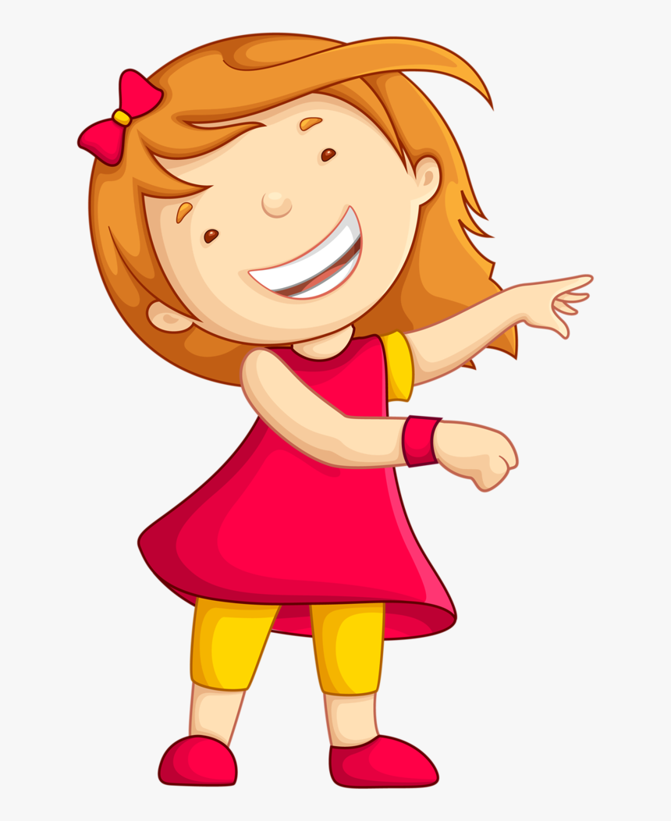
Dear Children, We will be looking ahead the given below concepts Numbers 1- 20. *Read and write Numbers up to 20 *Count forward and backward
I am ready Ma’am!!

Slide 6
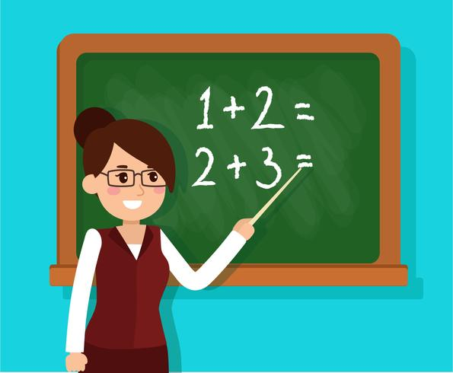
Lets begin the class with a quick counting activity.

Slide 7
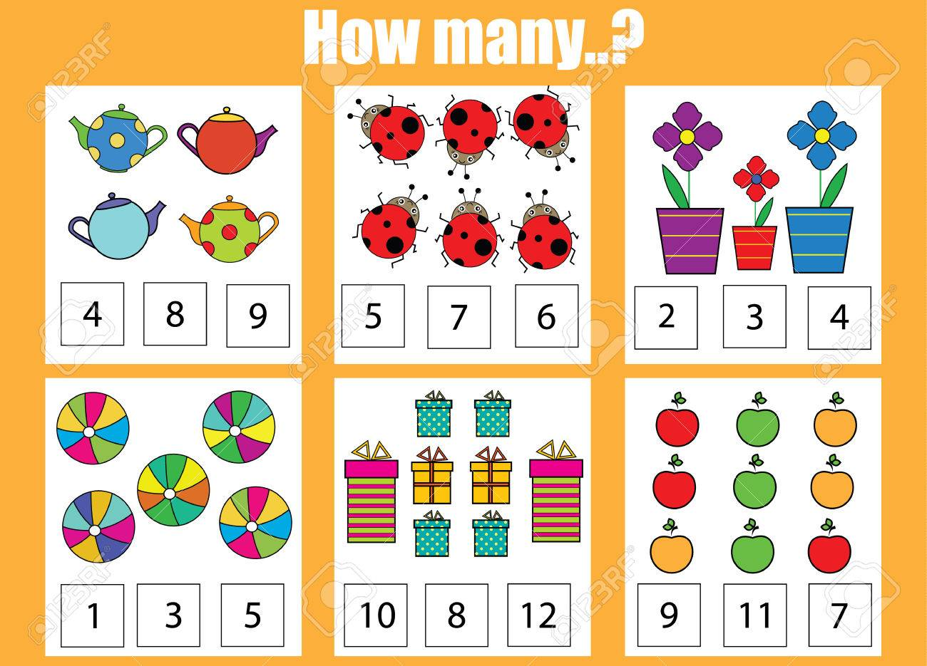

Slide 8

That was brilliant!! Children, Now we will look at the number grid and do the counting from 1-20. Here we go…

Slide 9
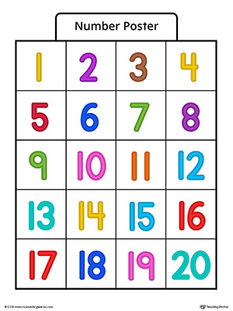
Come on little ones start counting from Number 1…

Slide 10

Let’s sing and learn numbers 1-20.
Click this link to sing and learn 1-20:
https://www.youtube.com/watch?v=d0ajq682yra

Slide 11
That was amazing!! You have learnt number names 1-20 in UKG so for a quick recap let’s us unscramble the number names in the worksheet. Shall we start?
https://www.liveworksheets.com/qc19662mp

Slide 12

Hurray!! You have unscrambled it !! Now its Quiz time. Children, Are you ready to answer the quiz. Yes! Here we go….

Slide 13
Quiz Time( 0-10)
1 How many wings do you have?
2. How many seeds are there in a mango?
3. How many eyes do you have?
4. How many wheels are there in a tricycle?
5. How many legs does a cow have?
6. How many fingers do you have in one hand?
7. How many legs does a grasshopper have?
8. How many colours are there in a rainbow?
9. How many legs does a spider have?
10. Who looks like 6 turned upside down?
11. How many fingers are there in both your hands?

Slide 14

Hope you enjoyed the quiz. For those who got all the answers correct a High Five for you!! For whose who couldn't , better luck next time! Now let’s read the number names from 1-20. Are you ready?

Slide 15
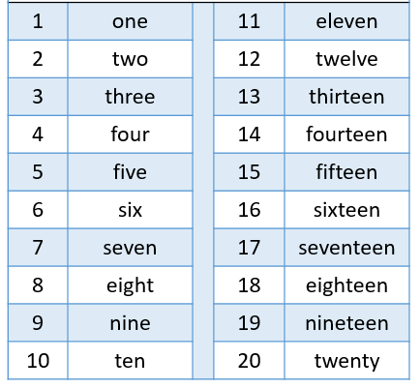

Slide 16
Teen words
13- Thirteen
14- fourteen
15- fifteen
16- sixteen
17- seventeen
18- eighteen
19- nineteen

Slide 17

Wow!! We have completed counting 1-20 and reading the number names.

Slide 18

Forward Counting: Counting from a smaller number to big number is called forward counting. We move to a bigger number as we move forward. Like if you have to count forward from 1 , how do we count? 1,2,3,4,5…… Yes!! This is called forward counting. Can you identify that the count increases or becomes greater when do forward counting.
Learning time:

Slide 19
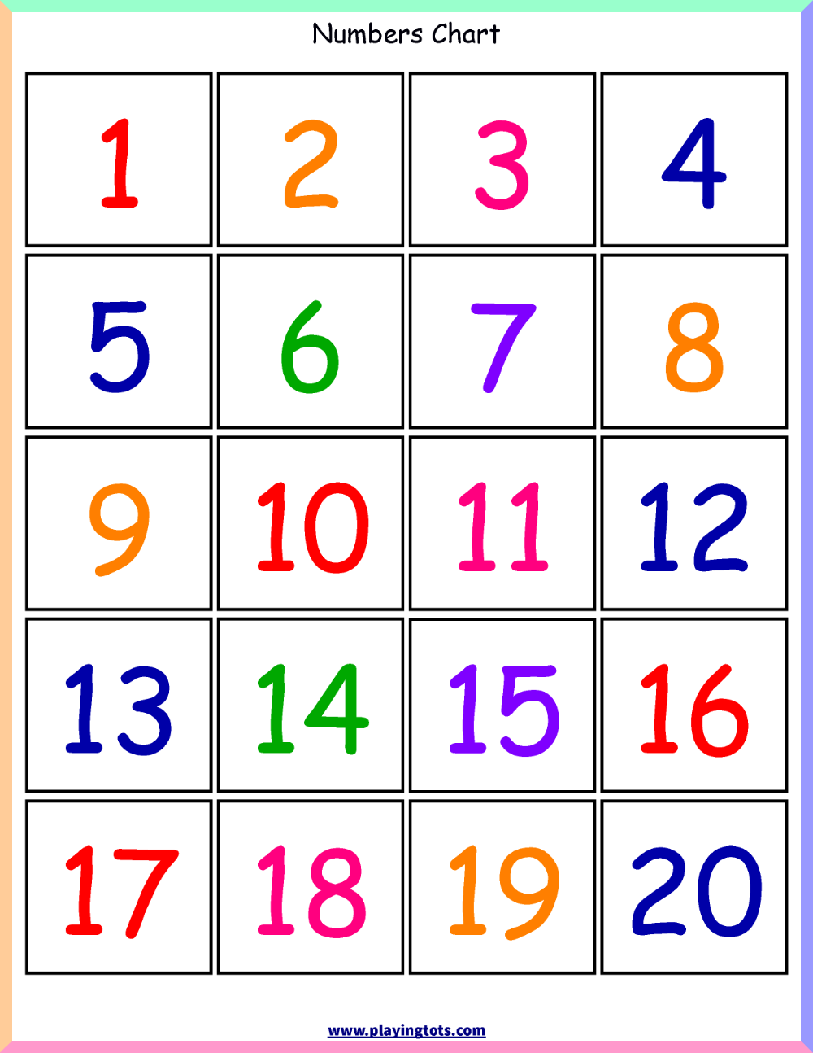
Start counting forward from 1

Slide 20
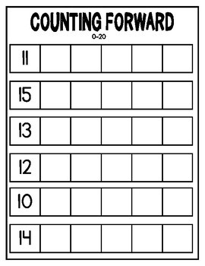
Time to count forward!!
Students can write the answers in the Math note book.
Teacher’s suggestion

Slide 21
Backward Counting: Counting from a bigger number to a smaller number is called backward counting. We move to a smaller number as we move backward. Like if you have to count backward from 10 , how do we count? 10, 9, 8, 7,6,5,4,3,2,1. Yes!! This is called backward counting. Can you identify that the count decreases or becomes lesser when do backward counting.
Learning time:

Slide 22
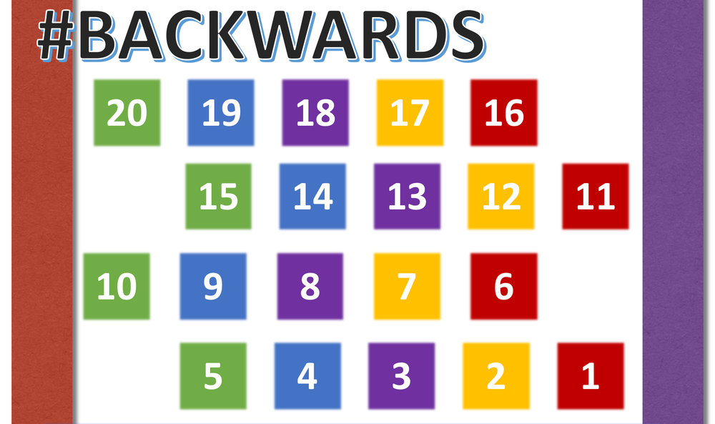
Time to count backward!!

Slide 23
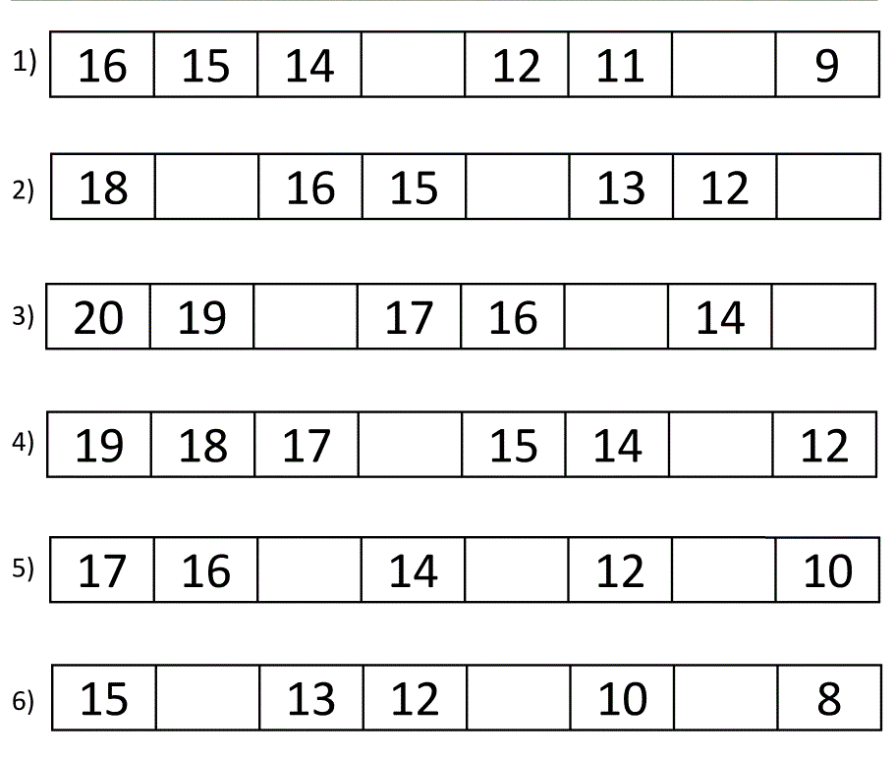
Time to count backward!!
Students can write the answers in the Math note book
Teacher’s suggestion

Slide 24
Practice Time 1:
Activity 1 – Fill the missing numbers from 1-20, click the below link: https://www.liveworksheets.com/sm797nr
Activity 2 - For recalling number names for 1-20, click the below link: https://www.liveworksheets.com/ep32123tj Activity 3: Materials needed- Math note book , pencil and an eraser. a. Write the numbers 1-20 B. Write the number names c. Read aloud the number names. d. Count forward and backward

Slide 25
Teacher’s Desk:
Children,
Today you have learnt:
Numbers 1-20
b. Number names 1-20
c. Forward counting
d,. Backward counting

Slide 26
From teacher’s desk: Thank you parents for helping your child to complete the assignments. In the next session we will focus on the other concepts related to numbers 1-20. Kindly note: Backward counting is challenging for our children so lets give them some time to understand the concept. At the end of the numbers concept they will master it.

